Slide 1
CS 3840 Applied Machine Learning
Terms and Principles of Machine Learning
Lingwei Chen
2022-01-12

Slide 2
Roadmap
What is machine learning?
Why use machine learning?
Key types of machine learning
Workflow of supervised machine learning
Feature representation
Linear classification

Slide 3
What Is Machine Learning?
[Machine Learning is the] field of study that gives computers the ability to learn without being explicitly programmed.
- Arthur Samuel, 1959
[Machine Learning is ] a computer program said to learn from experience E with respect to some task T and some performance measure P, if its performance on T, as measured by P, improves with experience E.
- Tom Mitchell, 1997

Slide 4
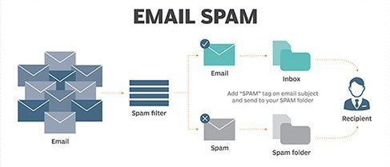
An Example – Spam Filter
Spam filter – a machine learning program learns to flag spam trained on examples of spam emails and examples of regular emails
Task T – flag spam for new emails
Experience E – the training data including spam emails and regular emails
Performance measure P – the ratio of correctly classified emails

Slide 5
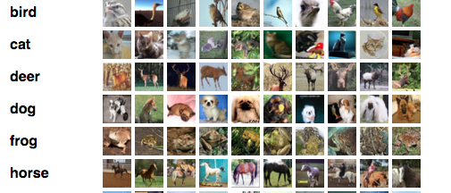
Another Example – Image Classification
ResNet, DenseNet, Inception-V3 – machine learning programs (deep neural networks) learn to recognize the categories of the images trained on CIFAR-100/ImageNet
Task T – recognize the objects displayed in the new images
Experience E – the training data (CIFAR-100/ImageNet) including images covering bird, cat, deer, dog, frog, horse…
Performance measure P – the ratio of correctly classified images

Slide 6
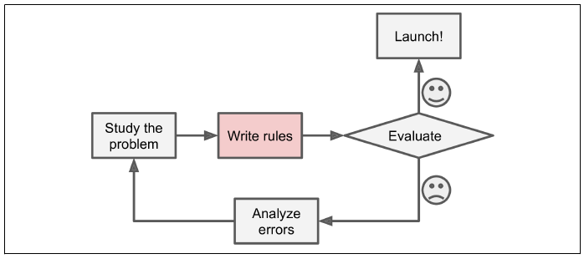
Why Use Machine Learning?
Traditional approach for spam filter
Analyze the emails to find the patterns of spam emails – some words (e.g., “4U”, “credit card”, “cash”, “free”) tend to come up a lot in the subject; different URLs; special sender’s name, …
Write a detection algorithm for each pattern, and the program only flag emails as spam if a number of these patterns are detected
Test the program, and repeat steps 1 and 2 until it is good enough

Slide 7
Why Use Machine Learning?
Traditional approach for spam filter
The number of emails is large, so the pattern analysis is non-trivial and the patterns are hard to be enumerated – the spam filtering ability is limited
The new spam emails with new spamming tricks emerge every day, and it’s very hard to update and maintain the long list of rules – the patterns easily get outdated, and the spam filtering is ineffective

Slide 8
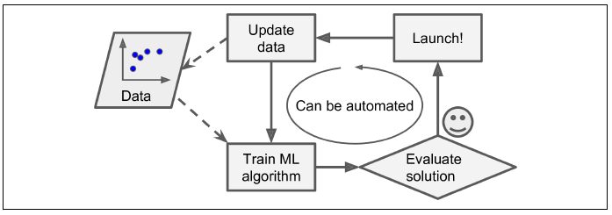
Why Use Machine Learning?
Machine learning approach for spam filter
Automatically learns which words and phrases are good predictors of spam by detecting unusually frequent patterns of words in the spam examples compared to the regular examples
The program is much shorter, easier to maintain, and most likely more accurate
New natural language processing techniques promote word embedding rather than feature engineering

Slide 9
Key Types of Machine Learning
Whether or not the machine learning models are trained with human supervision
Supervised learning – learned from data labeled by human
Unsupervised learning – no labeled data
Semi-supervised learning – learned from labeled and unlabeled data. This especially works on the graph structured data and network data
We mainly focus on supervised learning and unsupervised learning

Slide 10
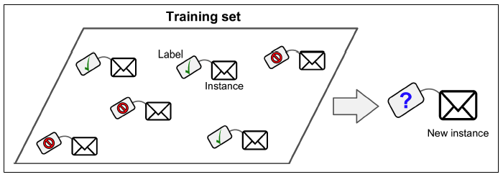
Supervised Learning
A machine learning model learns the data using known labels and is then used to perform tasks on the new data
Label – a class or category an instance belongs to
Training data – a set of data instances with labels that are used to learn the relationship between the input and output
Test data – a set of unseen instances that are used to evaluate the performance of the trained model

Slide 11
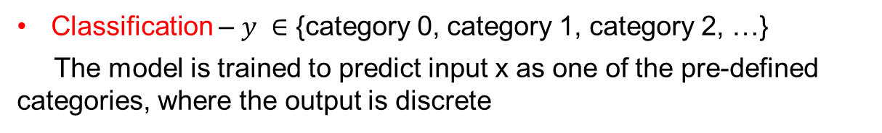
Supervised Learning - Classification
Training input x
f
Output y
Classification – $y ∈$ {category 0, category 1, category 2, …}
The model is trained to predict input x as one of the pre-defined categories, where the output is discrete
Examples – spam classification (spam/regular), malware detection (malicious/benign), image classification (cat, dog, ….), human attribute inference such as gender, profession, political views, …

Slide 12
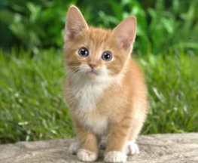
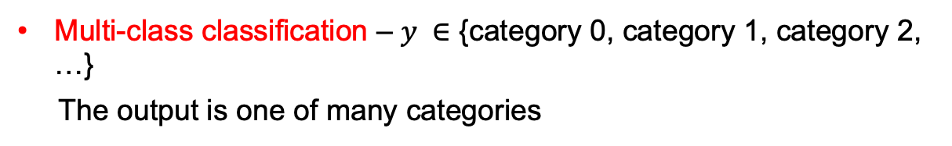
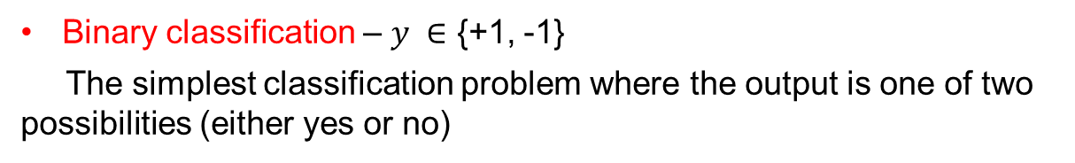
Supervised Learning - Classification
Training input x
f
Output y
Binary classification – $y ∈$ {+1, -1}
The simplest classification problem where the output is one of two possibilities (either yes or no)
Multi-class classification – $y ∈$ {category 0, category 1, category 2, …}
The output is one of many categories
f
cat

Slide 13
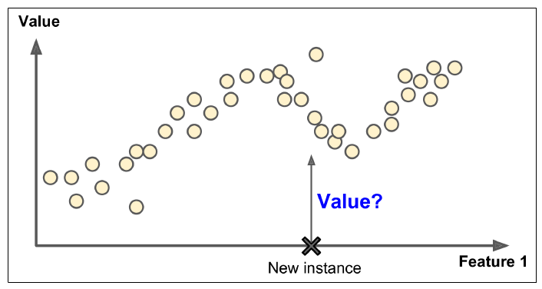
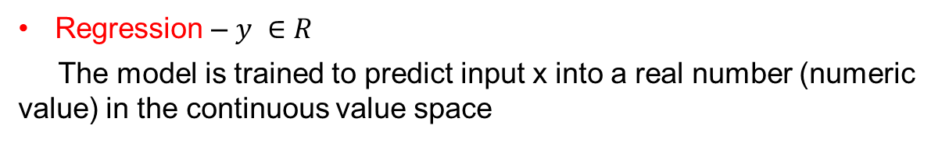
Supervised Learning - Regression
Training input x
f
Output y
Regression – $y ∈R$
The model is trained to predict input x into a real number (numeric value) in the continuous value space
Example – given the location and built year, predict the house price

Slide 14
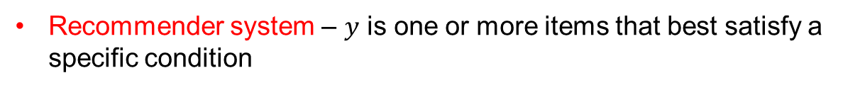
Supervised Learning – Other Prediction Tasks
Ranking – $y$ is a permutation
1,2,3,4
f
2,4,3,1
Structure prediction – $y$ is an object which is built from parts
Uno dos tres
f
One two three
Recommender system – $y$ is one or more items that best satisfy a specific condition
User activities in Amazon
f
Products for users

Slide 15
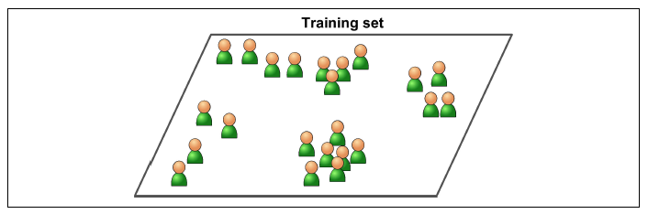
Unsupervised Learning
A machine learning model groups the data into different categories using feature distribution without any labels to help
The data is trained by measuring the distance between the training samples’ feature spaces
The group of the test data is generally decided by the closest distance between the test data and the samples in each group

Slide 16
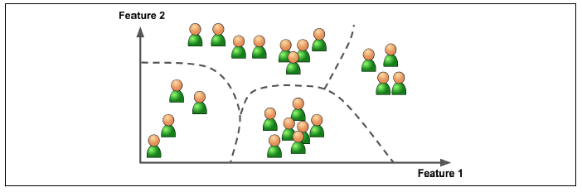
Unsupervised Learning - Clustering
Clustering – identify the similarities between objects and group the objects according to the characteristics in common and differentiate them from other groups of objects
Groups are called clusters
Example – Clustering is used in projects for companies that want to find common aspects within their customers

Slide 17
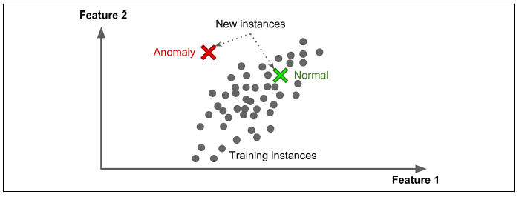
Unsupervised Learning – Anomaly Detection
Anomaly detection – identifies data points, events, and/or observations that deviate from a dataset's normal behavior
Example – detecting unusual credit card transactions to prevent fraud, catching manufacturing defects, or automatically removing outliers from a dataset before feeding it to another learning algorithm

Slide 18
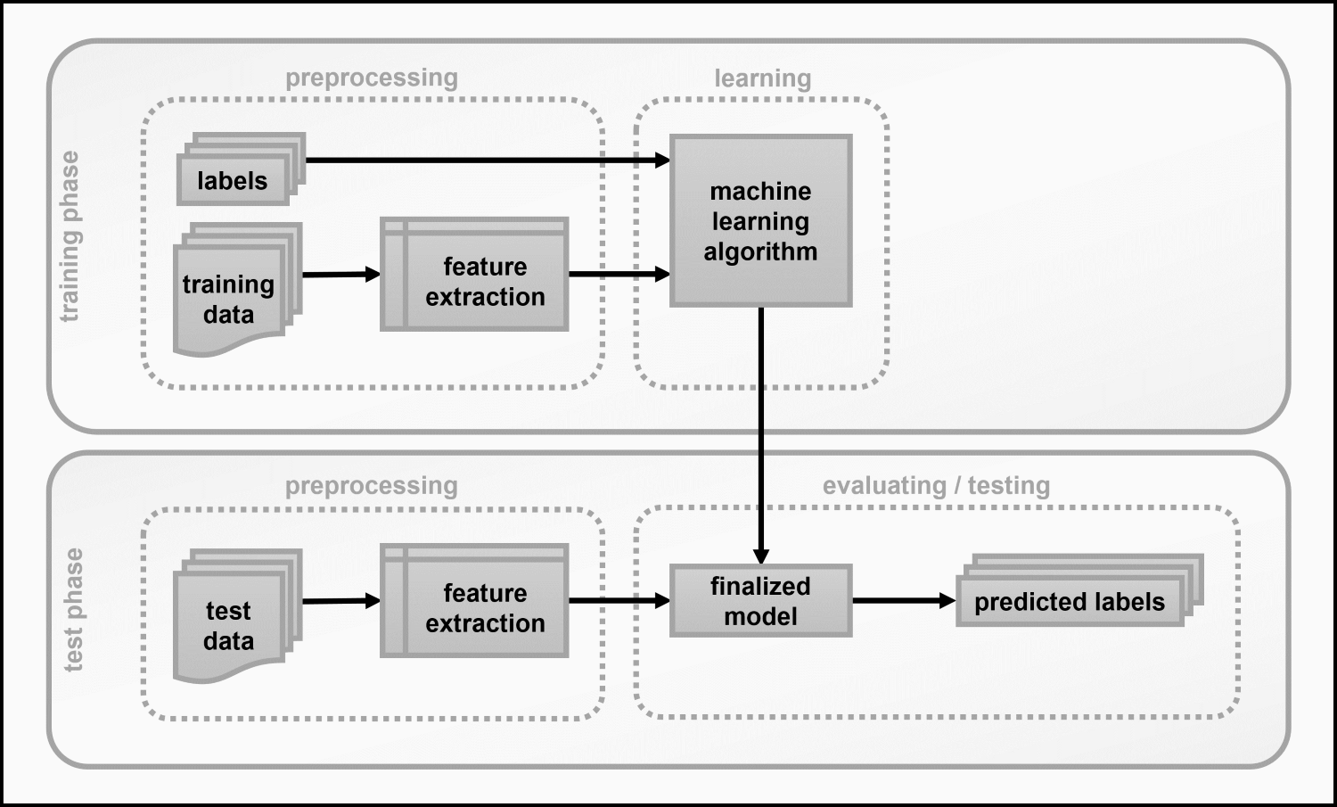
Workflow of Supervised Machine Learning
Feature representation – represent the input data x in terms of something that the computer can understand
Optimization – search for the optimal settings/parameters that give the model with the best evaluation performance

Slide 19
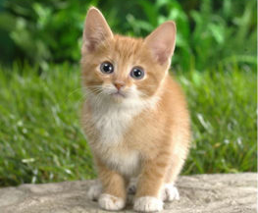

Feature Representation
To: Chris
From: Daniel
Subject: Next course offering
Hi Daniel,
Could you please send the outline for the next course offering? Thanks! -- Chris
A list of words with their frequency
Email
A matrix of color values (pixels)
Picture
A set of attribute values (dorsal fin? Stripes? Color, and Length)
Sea creatures

Slide 20
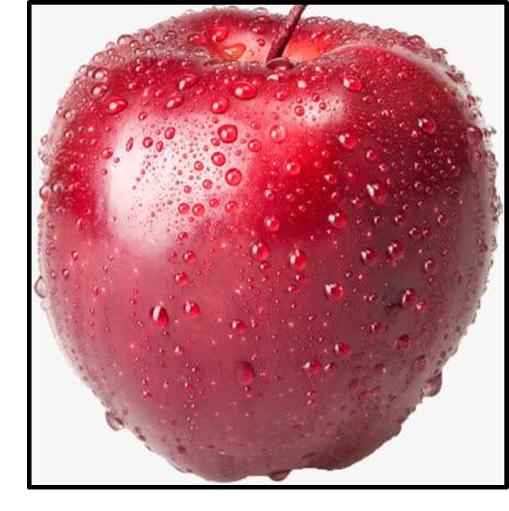
Feature Representation
Length
Feature vector
Mass | Width | Height | Color
102 | 7.6 | 7.1 | 0.83
Height
f
Color
Mass
Predict apple

Slide 21
Linear Classification

Slide 22
Linear Classification
Example task – predict y, whether a string x is an email address
Question – what features of x might be relevant for predicting y?
Feature extraction/representation – given input x, output a set of feature name and feature value pairs
Length > 10 1
FracOfAlpha 0.85
Contains_@ 1
EndsWith_.com 1
EndsWith_.org 0
abc@gmail.com

Slide 23
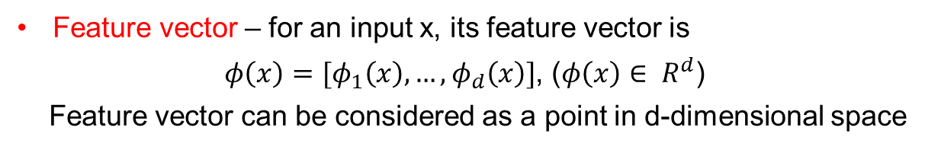
Feature Vector Notation
Mathematically, feature vector doesn’t need feature names but values
Length > 10 1
FracOfAlpha 0.85
Contains_@ 1
EndsWith_.com 1
EndsWith_.org 0
1
0.85
1
1
0
Feature vector – for an input x, its feature vector is
$φ\left(x\right)=[φ_{1}\left(x\right), …,φ_{d}\left(x\right)]$, ($φ\left(x\right)∈ R^{d}$)
Feature vector can be considered as a point in d-dimensional space

Slide 24
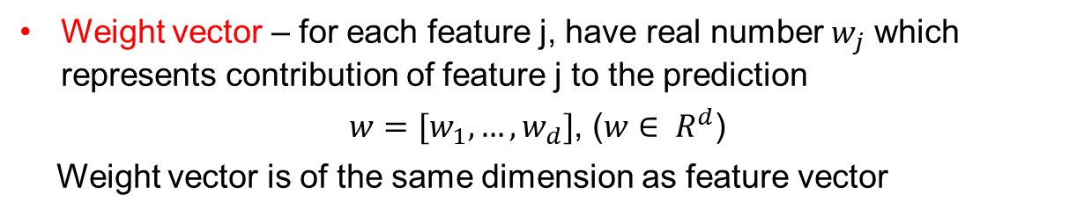
Weight Vector
Weight vector – for each feature j, have real number $w_{j}$ which represents contribution of feature j to the prediction
$w=[w_{1}, …,w_{d}]$, ($w∈ R^{d}$)
Weight vector is of the same dimension as feature vector
Length > 10 -1.2
FracOfAlpha 0.6
Contains_@ 3
EndsWith_.com 2.2
EndsWith_.org 1.4
Weight vector

Slide 25
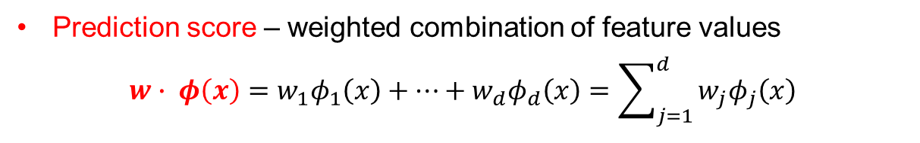
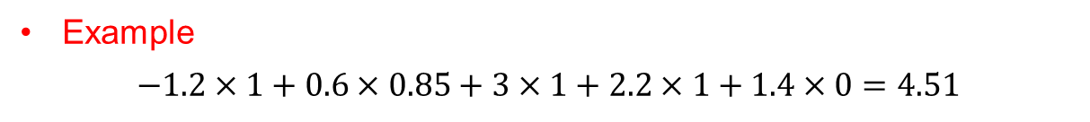
Linear Classification
Length > 10 -1.2
FracOfAlpha 0.6
Contains_@ 3
EndsWith_.com 2.2
EndsWith_.org 1.4
Length > 10 1
FracOfAlpha 0.85
Contains_@ 1
EndsWith_.com 1
EndsWith_.org 0
Weight vector
Feature vector
Prediction score – weighted combination of feature values
$$w∙ φ\left(x\right)=w_{1}φ_{1}\left(x\right)+…+w_{d}φ_{d}\left(x\right)=\sum_{j=1}^{d}{w_{j}φ_{j}\left(x\right)}$$
Example
$$−1.2×1+0.6×0.85+3×1+2.2×1+1.4×0=4.51$$

Slide 26
Next Class
(2022-01-19)
Terms and Principles of Machine Learning - Continued

